Slide 1
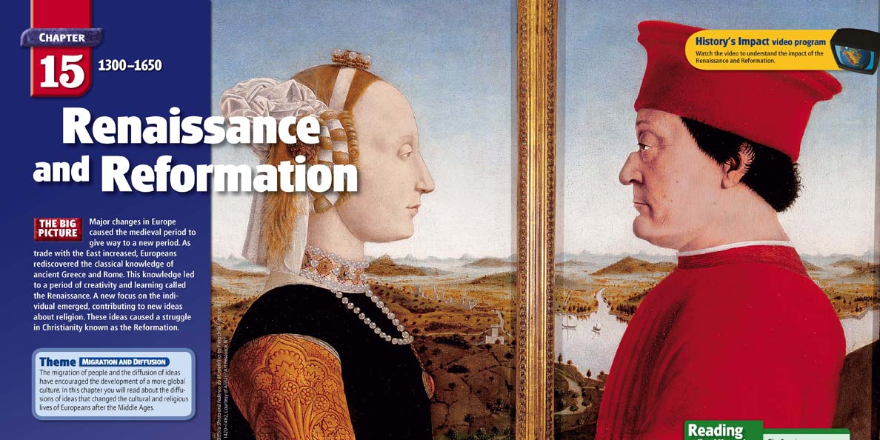

Slide 2
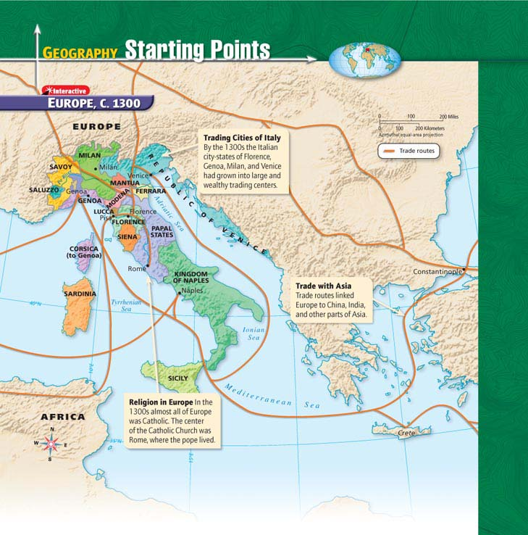
Click the icon to play Listen to History audio.
Click the icon below to connect to the Interactive Maps.

Slide 3
The Italian Renaissance
Main Idea
In Italy the growth of wealthy trading cities and new ways of thinking helped lead to a rebirth of the arts and learning. This era became known as the Renaissance.
Reading Focus
What changes in society and in cities stimulated the beginning of the Renaissance?
What ideas formed the foundation of the Italian Renaissance?
What contributions did artists make to the Renaissance?

Slide 4
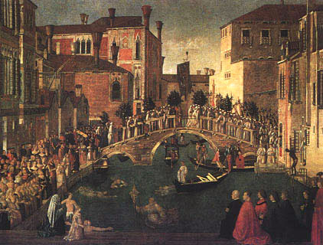
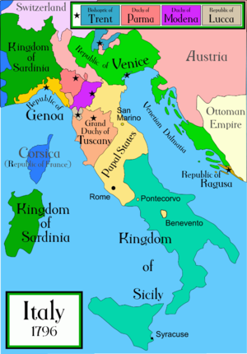
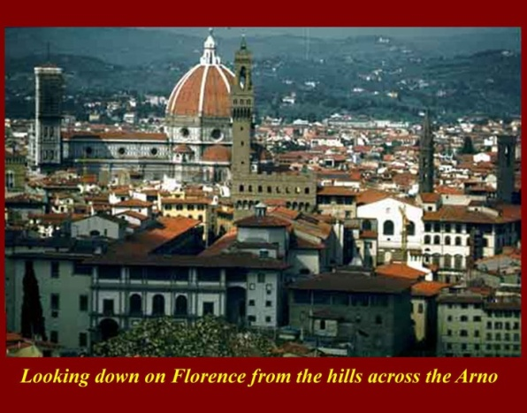
The Beginning of the Renaissance
Michelangelo’s painting was different from the art of the Middle Ages, and only one way in which European society began changing after the 1300s.
The Rise of City-States
Urban areas specialized, particularly in Italy
Italy divided into several large city-states in north, various kingdoms, Papal States south
Catholic Church, nobles, merchants, artisans dominated society in city-states
Many sought to display new wealth with knowledge of arts

Slide 5
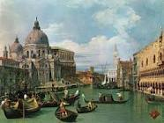
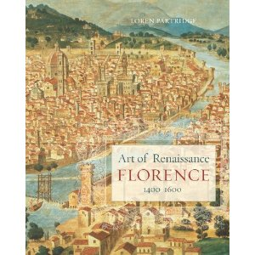
Venice
With access to sea, Venice built economy, reputation on trade
Had long history of trading with other ports on Mediterranean Sea
Shipbuilding prospered, sailors traveled to Near East
Wealthy Venetian merchants built unique city, “work of art”
Milan, Florence
Milan, west of Venice, based economy on agriculture, silk, weapons
Florence, to south, famous for banking, cloth
Monarchs appealed to Florentine bankers for money to fund wars
Merchants refined raw wool into fine cloth
Bankers, merchants created a city to rival any in Europe

Slide 6
Renaissance Ideas
As the economy and society changed, new ideas began to appear. This period of interest and developments in art, literature, science and learning is known as the Renaissance, French for “rebirth.”
Inspiration from the Ancients
New World of Ideas
Different Viewpoints
Venetian ships carried goods for trade and Greek scholars seeking refuge
Scholars brought back ancient works thought to be lost
Italians who could read looked for more information
Read Arabic translations of original texts
Searched libraries, found lost texts
As they read, began to think about philosophy, art, science in different ways
Began to believe in human capacity to create, achieve

Slide 7
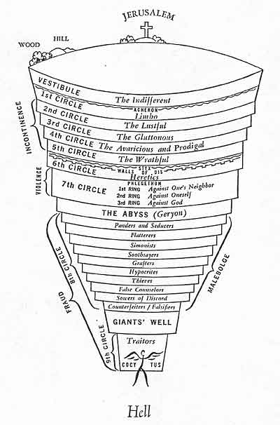
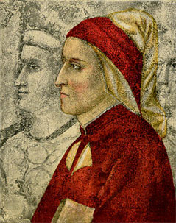
Humanism
Interest in ancient Greek, Roman culture
Scholastic education: rhetoric, grammar, poetry, history, Latin, Greek
Subjects came to be known as humanities-known as humanism
Humanists emphasized individual accomplishment
Roots traced to work of Dante; work contained glimpses of what would become focus on human nature
Historians believe Renaissance began with two humanists who lived after Dante—Giovanni Boccaccio, Francesco Petrarch
Both wrote literature in everyday language not Latin

Slide 8
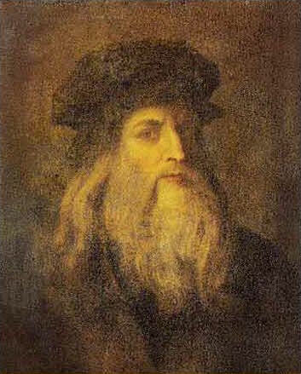
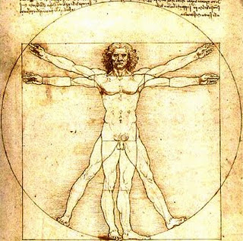
Secular Writers
Early 1500s life in Italy seemed insecure, precarious
Church no longer served as source of stability, peace
Form of humanism developed from Petrarch’s ideas; focus was secular, was worldly rather than spiritual
Renaissance Man
Ideal Renaissance man came to be “universal man,” accomplished in classics, but also man of action, who could respond to all situations.

Slide 9
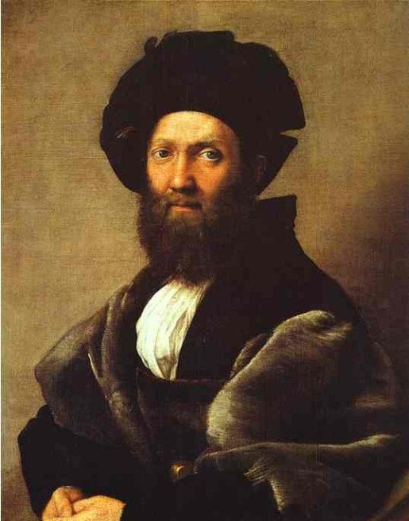
Examples of Renaissance Men
How to Act
Italian diplomat Baldassare Castiglione wrote book, The Courtier
Described how perfect Renaissance gentleman, gentlewoman should act
Castiglione gave nobles new rules for refined behavior in humanist society
Speak of serious, amusing subjects, know Latin & Greek
Be well-acquainted with poetry, history; be able to write prose, poetry
How to Rule
Philosopher, statesman Niccolò Machiavelli also wrote influential book
Experiences with violent politics influenced opinions on how governments should rule in The Prince

Slide 10
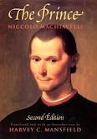
Machiavelli
Machiavellian advice seemed to encourage harsh treatment of citizens, rival states
Describes men as “ungrateful, fickle, liars, and deceivers”
Advises rulers to separate morals from politics
Power, ruthlessness more useful than idealism
Ruler must do whatever necessary to maintain political power, even if cruel-“the end justifies the means”
Idea that state an entity in itself, separate from its ruler, became foundation for later political philosophy

Slide 12
Renaissance Art
The arts a reflection of the new humanist spirit
Medieval artists—idealized and symbolic representations
Renaissance artists depicted what they observed in nature
Patrons of the Arts
Competition Among Patrons
Medieval times, anonymous artists who worked for church created art
Renaissance artists worked for whoever offered them highest price
Buyers of art, patrons, might be wealthy individuals, city governments, or church
Wealthy individuals competed, displaying wealth, modernity through purchase of artworks
Florence, Lorenzo de Medici supported most talented artists
Milan, ruling Sforza family benefactors of artists, others
Renaissance artists wanted to paint the natural world as realistically as possible.

Slide 13
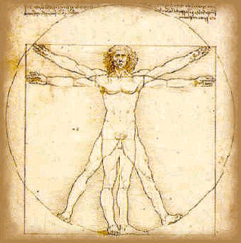
Leonardo da Vinci
Highly talented in all fields
His paintings are still studied and admired
Wrote out ideas, filling 20,000 pages of notes
His interests, enthusiasm boundless

Slide 14
Michelangelo
Michelangelo
Sculpture, Painting
Studied anatomy
Age 24, won fame with Pietà, sculpture of Jesus’ mother Mary holding son’s dead body
Sculpture communicates grief, love, acceptance, immortality
Marble statue of David
Most famous painting, artwork on ceiling of Sistine Chapel
Scenes from Old Testament considered one of greatest achievements in art history

Slide 15
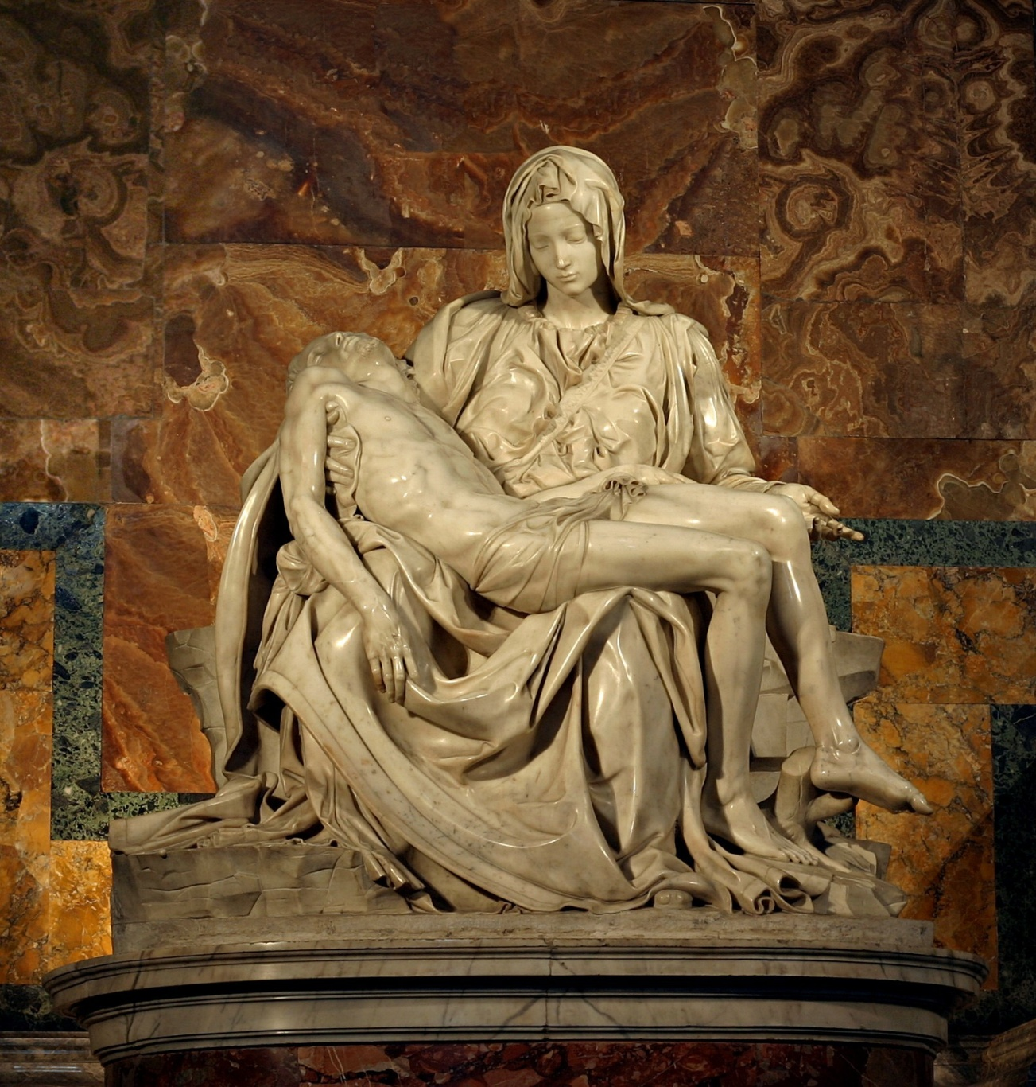
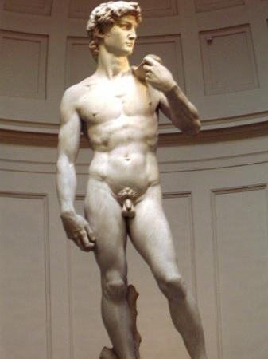
The Pietà & David

